Slide 1
Programming Made Easy
Bartek Wasielak

Slide 2




About me
Bartek Wasielak
@bwasielak

Slide 3
Agenda
Programming in general
Different techs and languages
Programming for the Web
Introduction to OOP
Hands On Lab

Slide 4
Programming in general

Slide 5
What can we achieve?
Build application no-one’s built
Modify existing app’s behaviour
Consume any data
Make your life easier
Fun!
Notes:
An application for my wife for time tracking – there was no simple free time tracking app

Slide 6
Different kind of applications
Desktop applications
Web applications
Mobile applications
Embedded applications
Notes:
Desktop apps are usually specific for a particular platform (operating system). Sometimes they can be OS agnostic. Usually not so robust as native ones.
Explain what native means.
Web application – works on a server side, presented to a user by a browser. Usually OS and browser agnostic. Sometimes use technology that requires specific OS/browser. Example: Flash doesn’t work on iOS. Silverlight has no official and current implementation for Linux (works on Windows and Mac only)
Embedded applications – robotic rovers, washing machines, home a

Slide 7
Technologies and languages

Slide 8
What does a computer do?
Computer programs are text documents
Programs are executed by a processor (CPU)
CPU doesn’t execute text

Slide 9
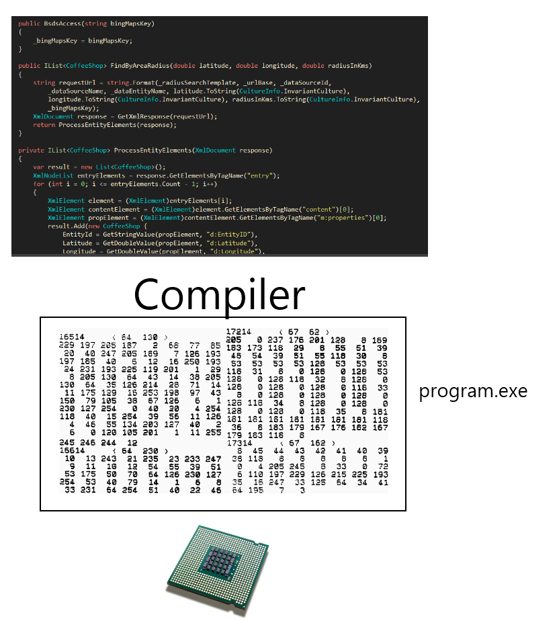
Compiling

Slide 10
Compiling
Maximum robustness
Need to compile against every CPU

Slide 11
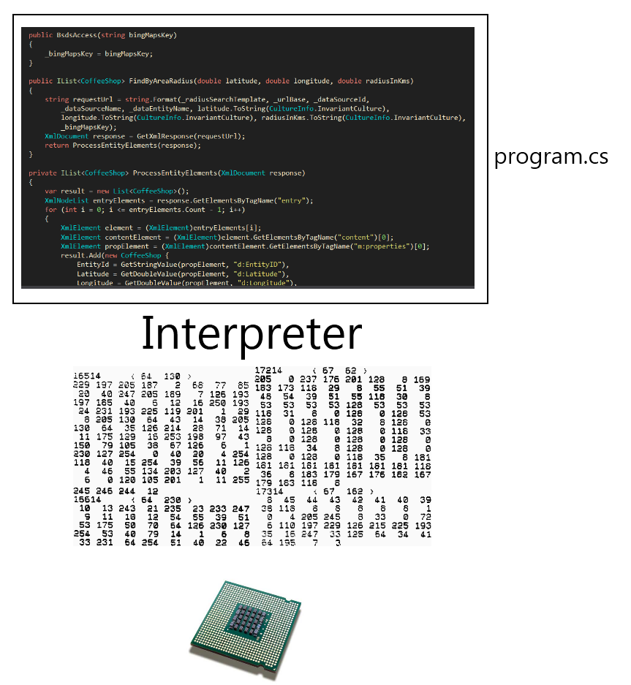
Interpretation

Slide 12
Interpretation
Poor efficiency
Need to have an interpreter for every OS/CPU
Everyone can see the code
No need to recompile
Notes:
Often used in the Web

Slide 13
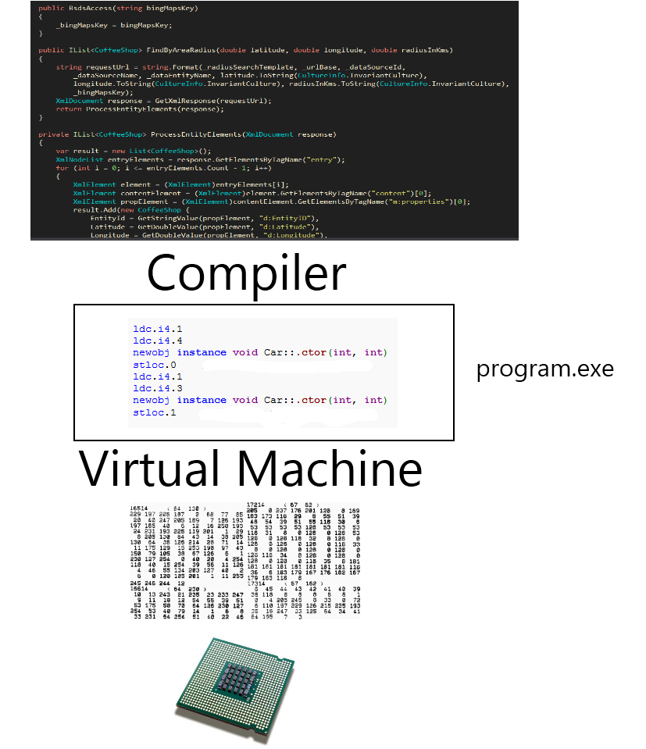
Virtual machine

Slide 14
Virtual machine
Medium efficiency
Compile once – to bytecode
Need to have a VM for every OS/CPU

Slide 15
The web - Web request
User types an address in a browser
The browser contacts a right server
The server recognizes the request
The server finds a program bound to the address
The program executes and returns an HTML document
The browser downloads the document
The browser executes all the code attached to the documents

Slide 16
Object Oriented Programming
Programming paradigm
Using objects
Each object is an instance of a class
Each class has fields and methods

Slide 17


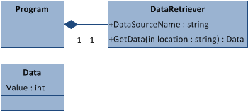
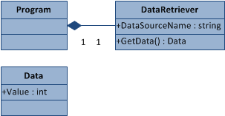
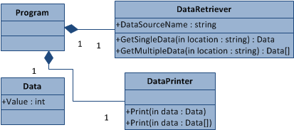
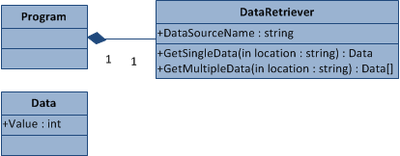
Object Oriented Programming

